Slide 1

Engineering the future

Slide 2
Latest change in Azure IoT portfolio
Event Grid MQTT broker is now GA!
February 2024

Slide 3
Agenda
About the autor
Event grid introduction
Event Grid MQTT vs IoT Hub MQTT
Live Demo
Q&A

Slide 4
About the author
01
Few totally not important things…

Slide 5


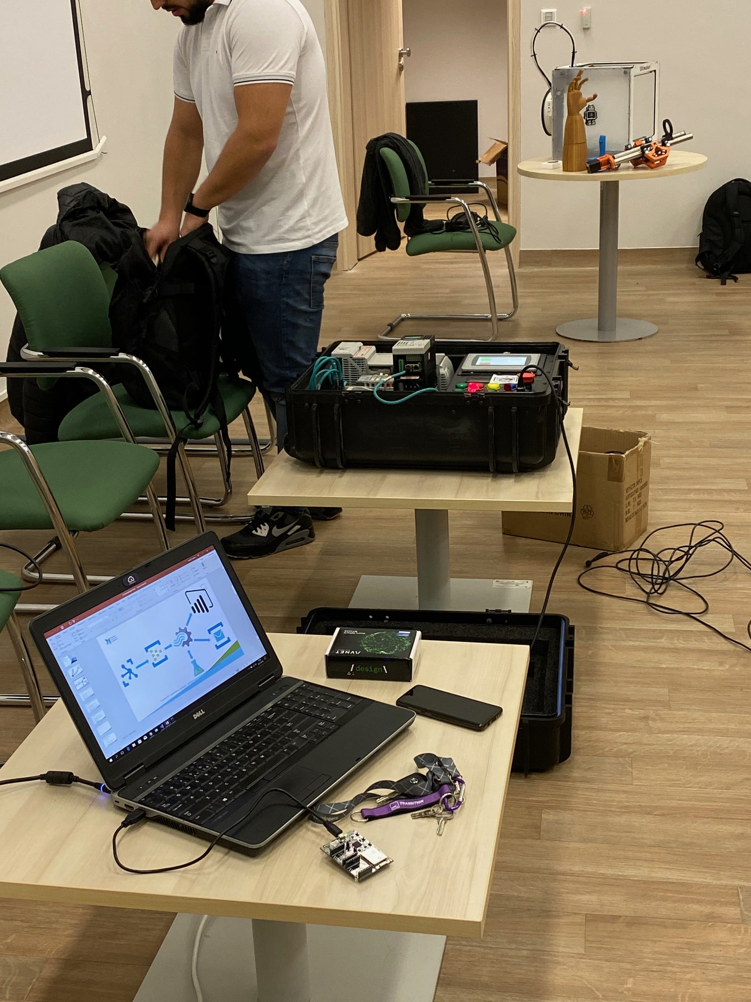


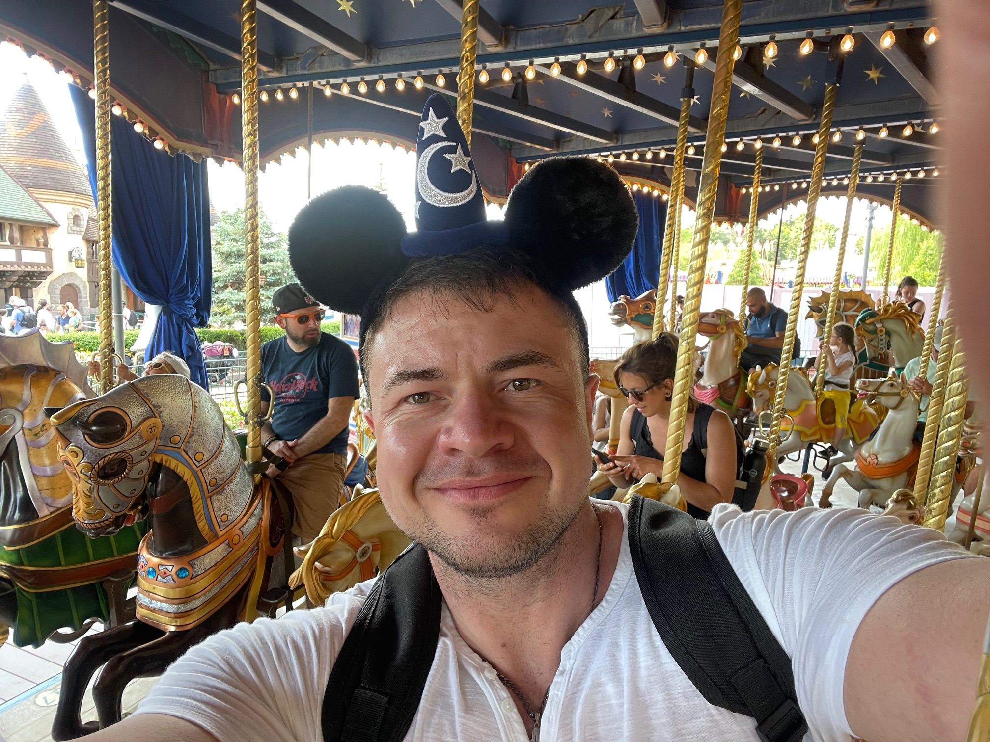
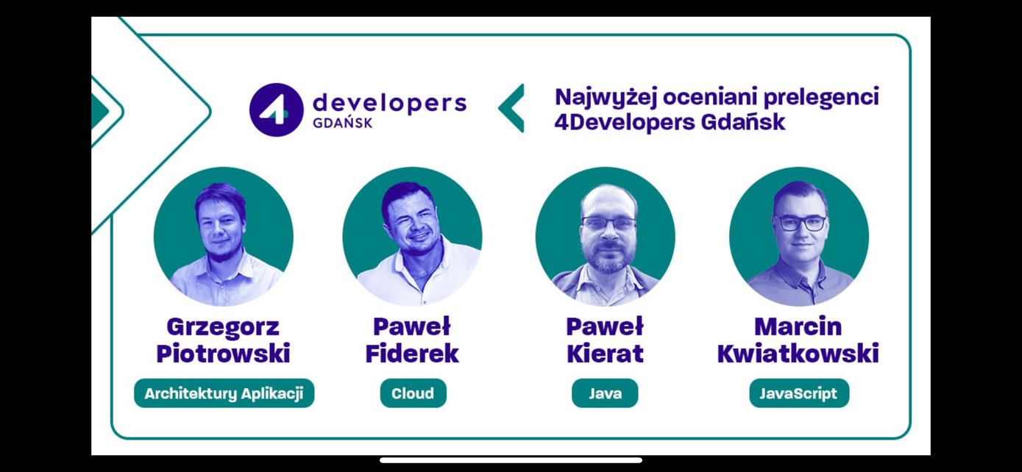
Pawel Fiderek
Cloud CTO Poland

Slide 6
EventGrid foundation
02
Basic introduction

Slide 7
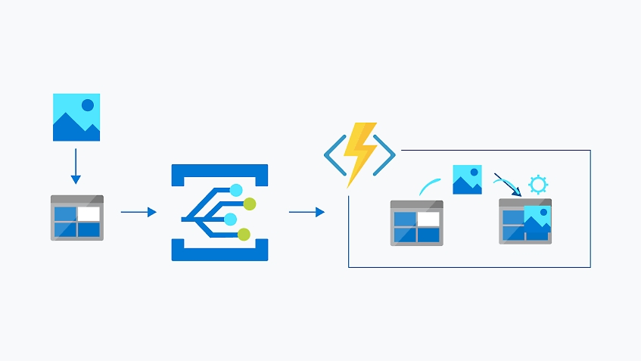
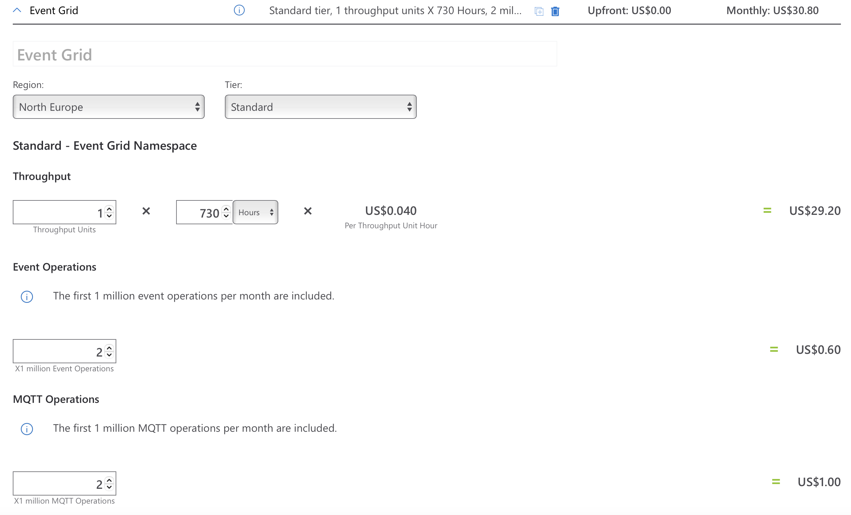
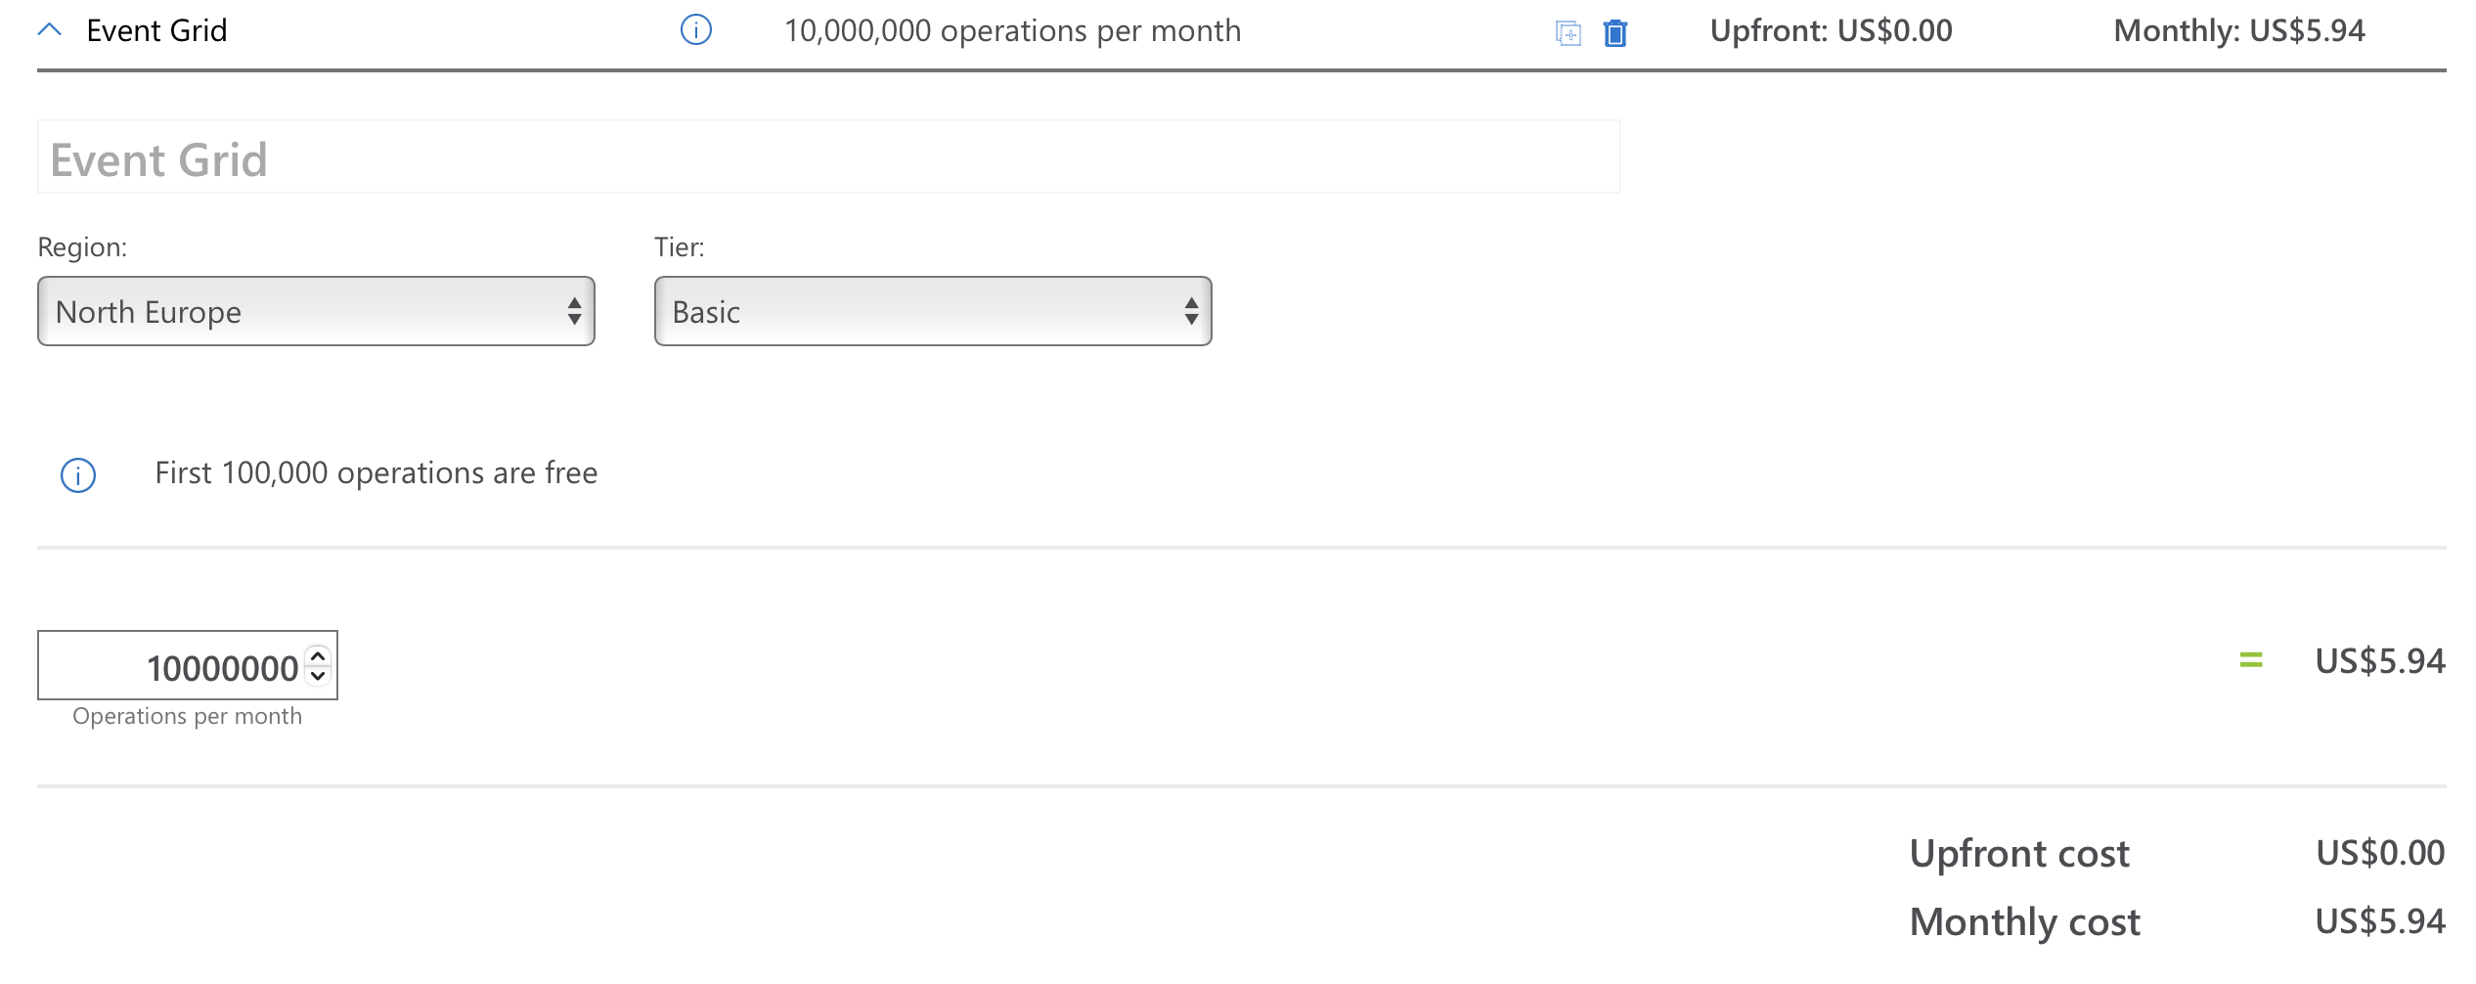
Event Grid
Theory behind a service
Fully serverless and managed
Designed as event source of truth in your solutions
Supports in build and custom topics
Device connected to IoT hub
New blob object was created in a container
New telemetry datapoint stored in queue
User session is inactive
Easy to integrate with other ingestion services like ie Event Hub
Available on AKS
New Mqtt functionality is now in GA

Slide 8
Event Grid vs Event Hub
03

Slide 9
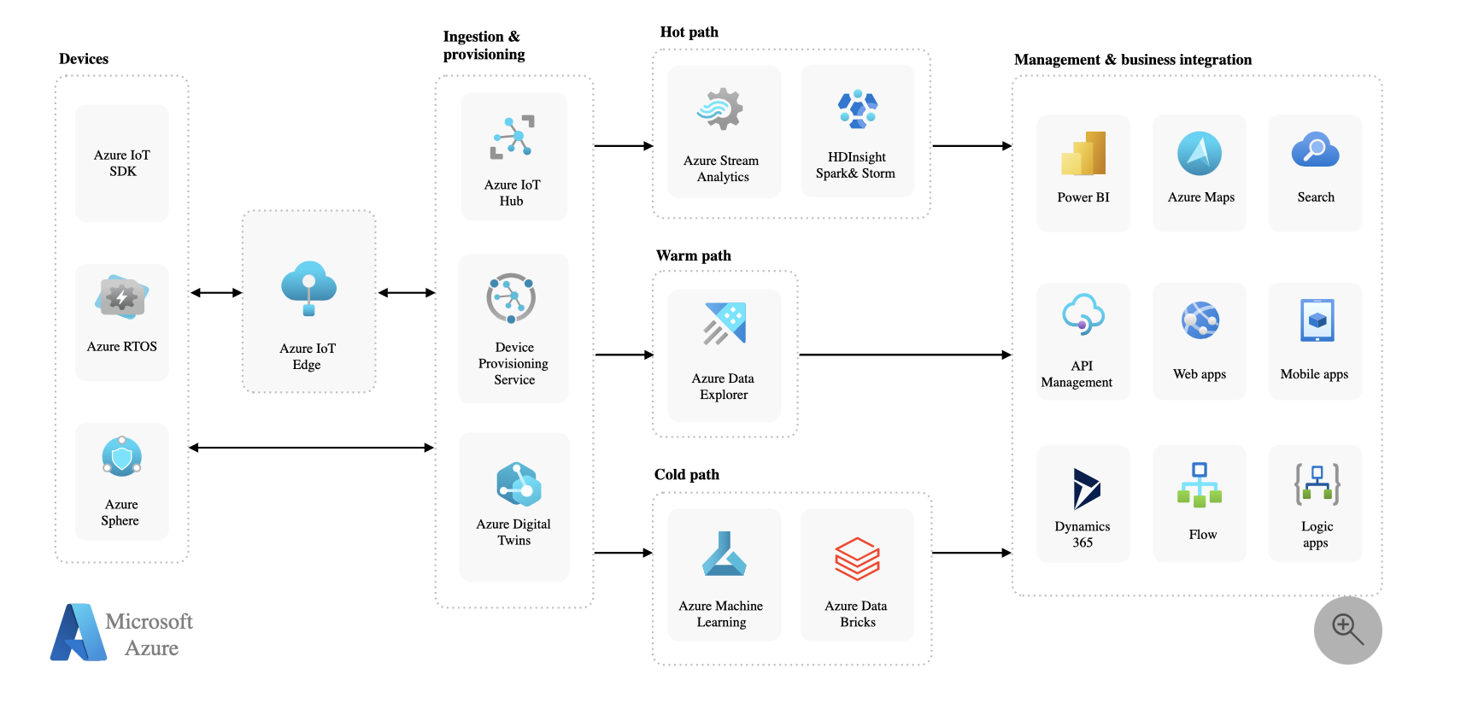
Event Grid IoT Hub
How it used to be?

Slide 10
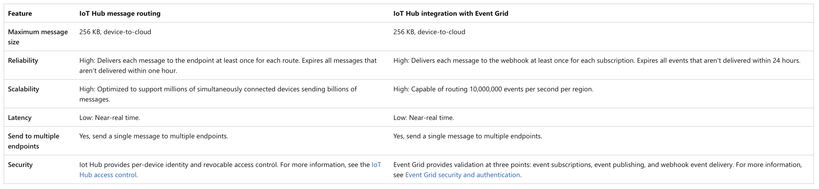
Event Grid IoT Hub
Why it is here? Main similarities between services

Slide 11
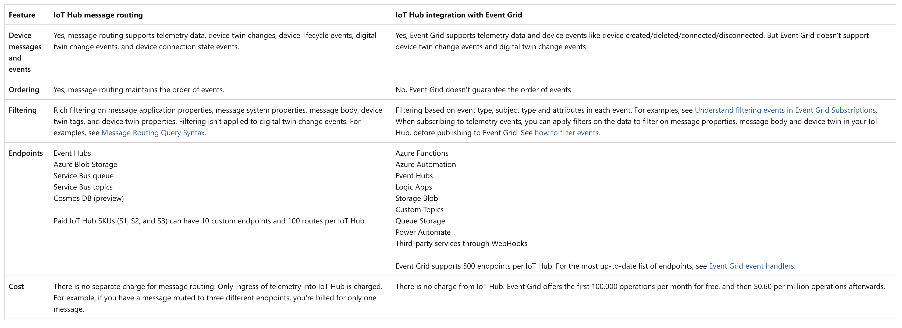
Event Grid IoT Hub
Ok – this is why! Main differences between services

Slide 12
Live demo
04
In cloud you need to keep your hands dirty, even for you sanity only ☺

Slide 13
Q&A
05
Let’s do some roast!

Slide 14
Engineering the future

Slide 15
Thank you!
For more information, contact
Pawel Fiderek
Director, Cloud CTO Poland
Pawel_Fiderek@epam.com

